Slide 1
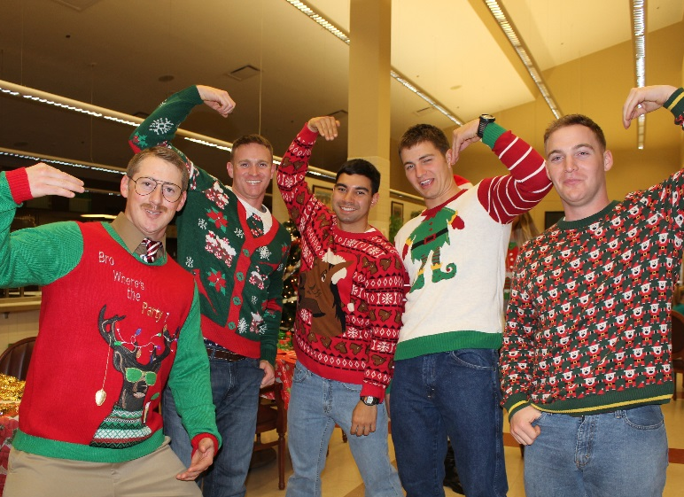
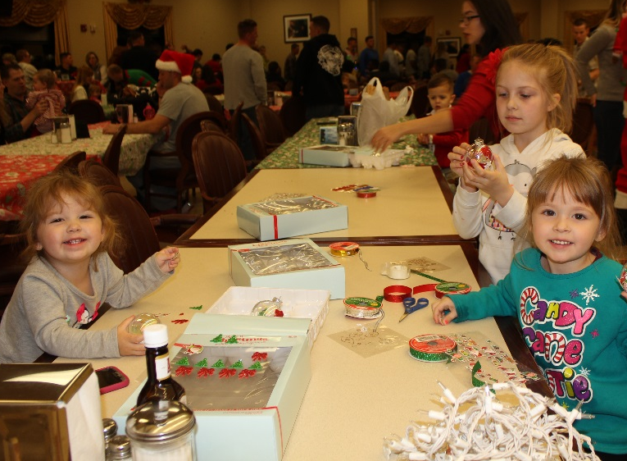
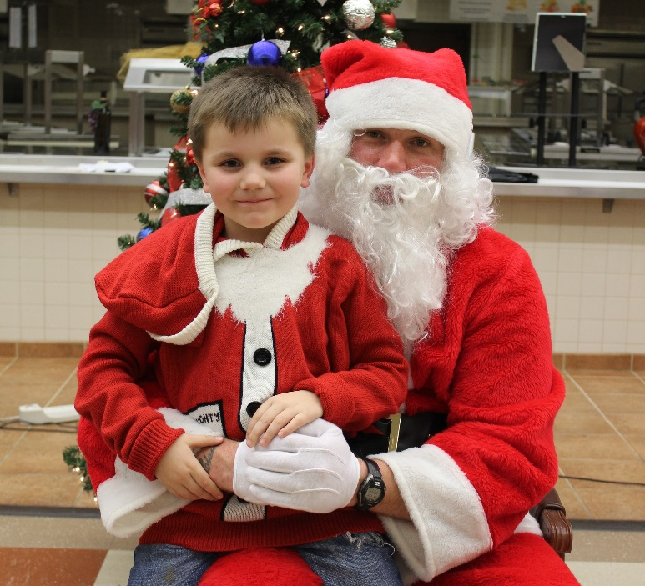
Bushmaster Holiday Party
Unit/Event: B/1-327 IN
Mission/Purpose: B Co, 1-327 IN hosts Bushmaster Holiday Party on 021800-2030DEC16 IOT reinforce Company Spirit and allow Soldiers to spend quality time with families and friends.
Summary of Events: Soldiers arrived at the Oasis Dining Facility around 1800. They walked into a well decorated venue with food, over the course of the night there was a best dessert and most festive attire competition, raffles, and Santa Claus with presents for all the children. During dinner, kids were asked to come to the front to take pictures with Santa and the Christmas tree to receive their gifts.
Bushmaster leaders showing the traditional “Hooks Up” symbol
Bushmaster children decorating Christmas ornaments
A Bushmaster child sitting on Santa’s lap
One of the many holiday themed center pieces used at the party
Timeline
02 DEC 16
1600: Pickup of all necessary equipment from the COF
1630: Setup of decorations and food
1800: First guests arrive
1820-1900: Dinner
1900-1940: Presents handed out to children age 14 and younger
1940-2000: Desert & Costume comp.
2030: Conclusion of Party/Take down
Statistics
Personnel Attended: Approximately 170 Party Length: 2.5 hours
Outputs: The party reinforced the Bushmaster pride and tight unit cohesion. Families and friends bonded together over a great meal and holiday atmosphere.
Commander’s Assessment: The Bushmaster Holiday Party was a great success. Because of the large turnout and the fellowship that was gained, we will make this an annual event. A big thank you to our sponsor city, Burlingame CA, for helping us monetarily and all of the volunteers who put in the hours to make this night a success.

Slide 2
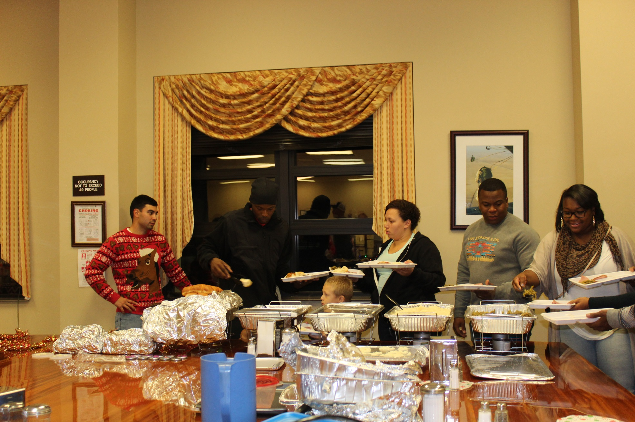
Bushmaster Holiday Party

Slide 3
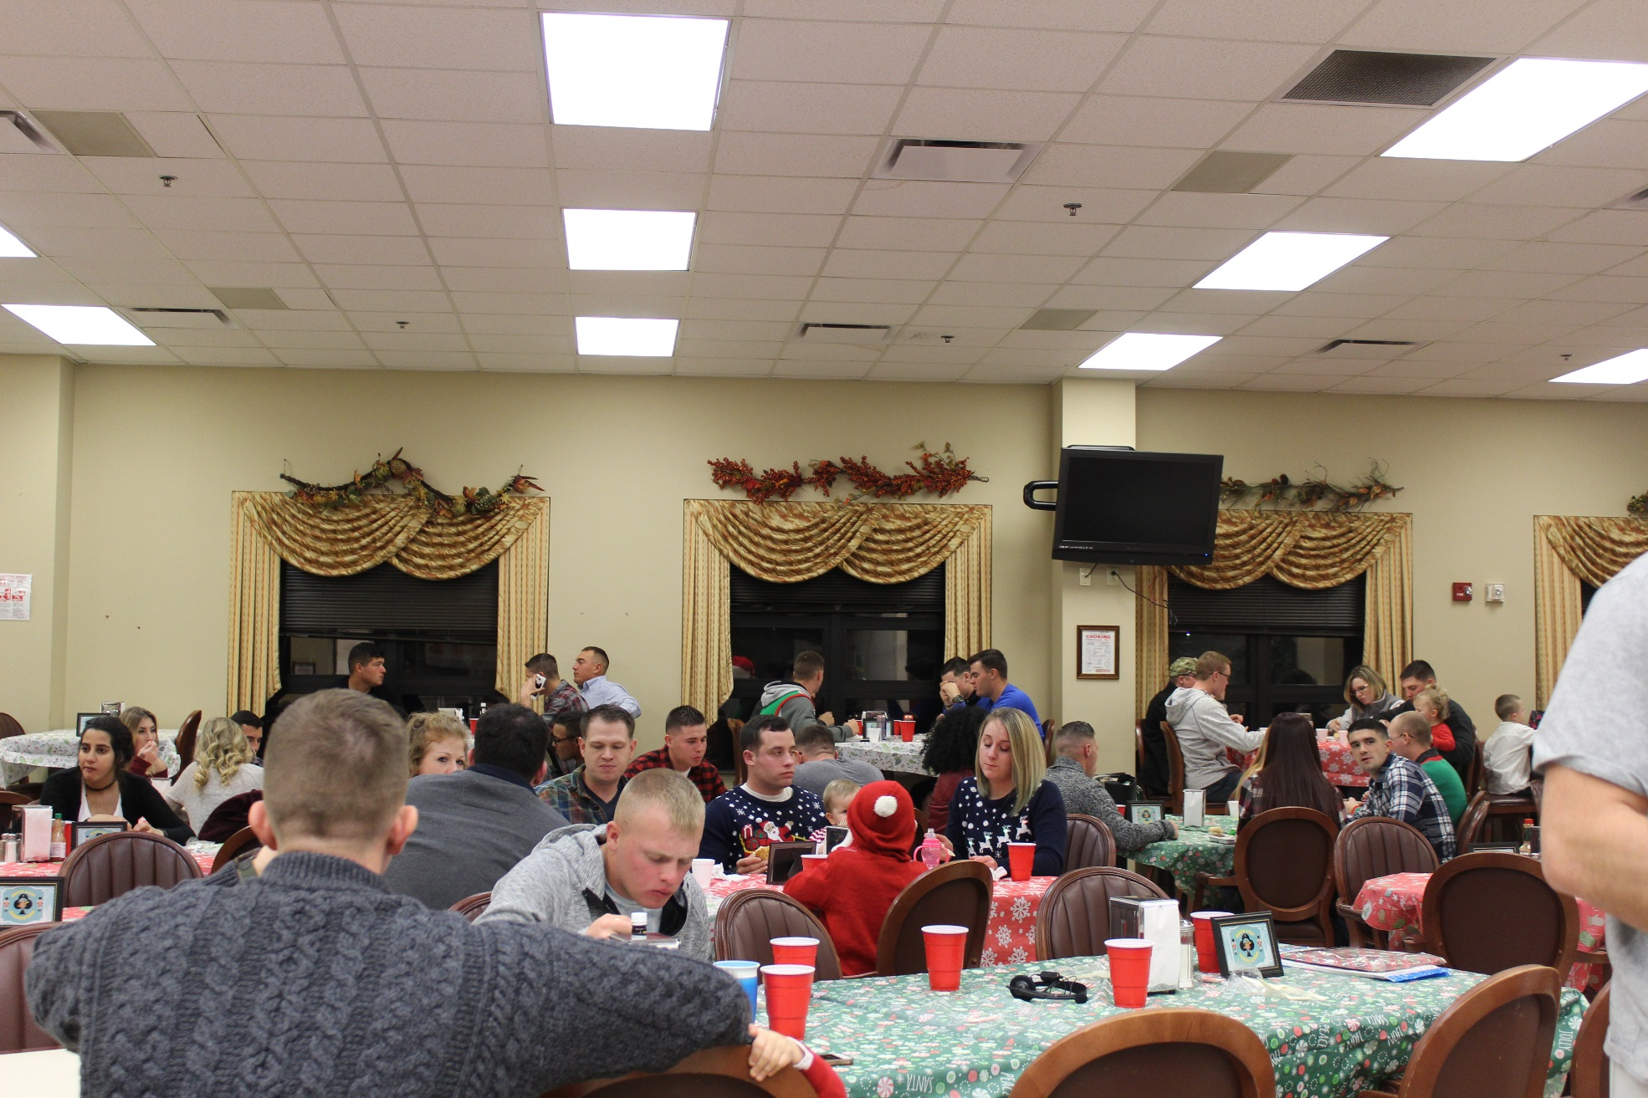
Bushmaster Holiday Party

Slide 4
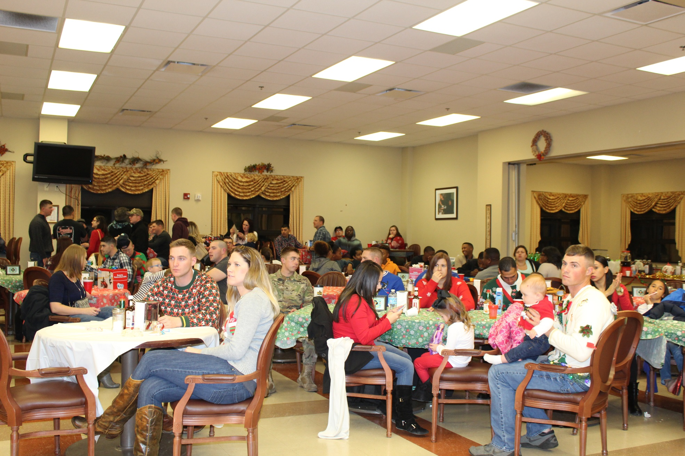
Bushmaster Holiday Party

Slide 5
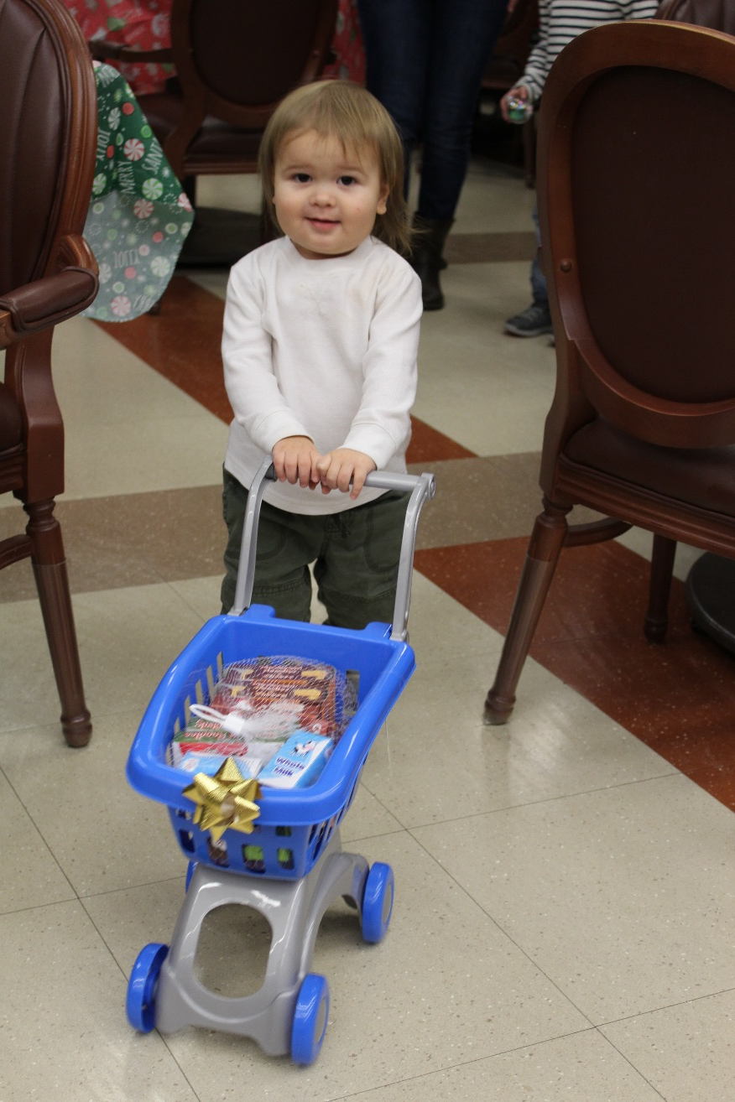
Bushmaster Holiday Party

Slide 6
Bushmaster Holiday Party

Slide 7
Bushmaster Holiday Party

Slide 8
Bushmaster Holiday Party

Slide 9
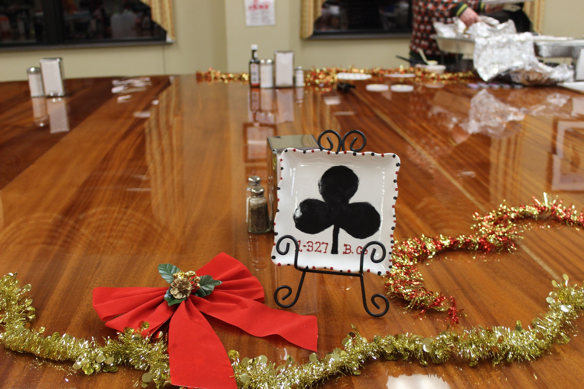
Bushmaster Holiday Party

